Slide 1
Understand and troubleshoot Cloud PC issues

Slide 2

Agenda
Introduction
Physical PC vs Cloud PC
Performance data
Gather useful logs
If all access fails

Slide 3



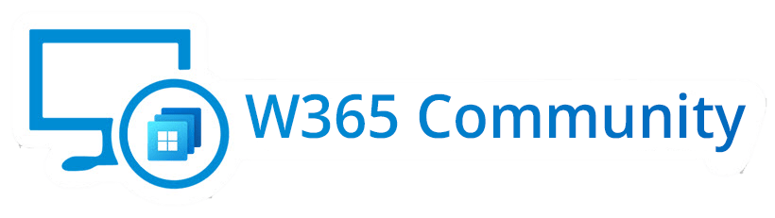


About me
Cloud Architect @ APENTO
8+ years as consultant
Passion for automation
Primary focus areas:
Windows 365
Azure Virtual Desktop
/in/mortenpedholt
@MortenPedholt
https://pedholtlab.com

Slide 4
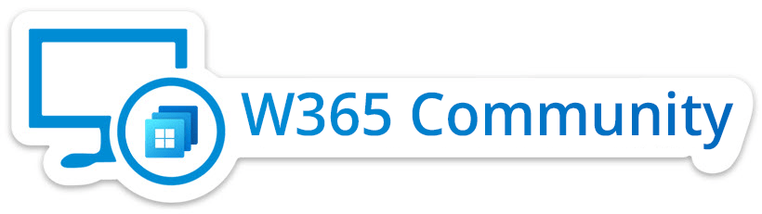
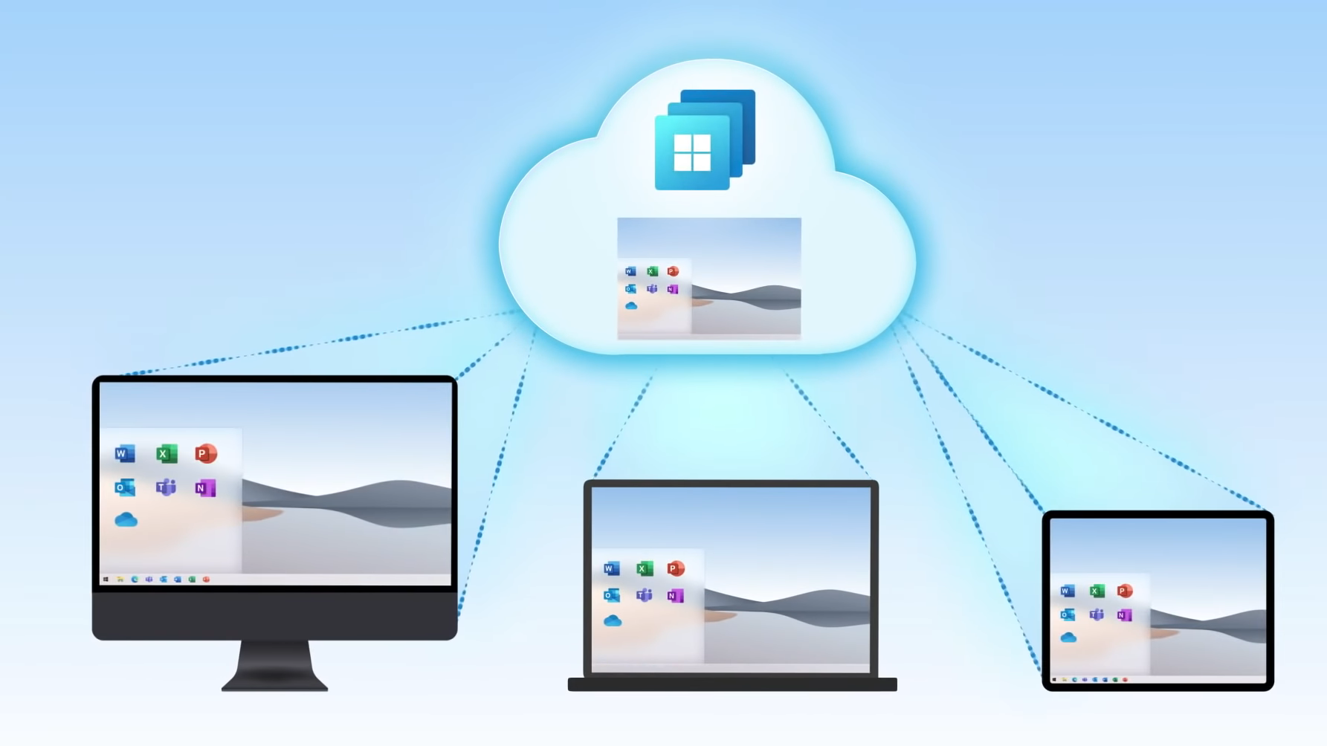
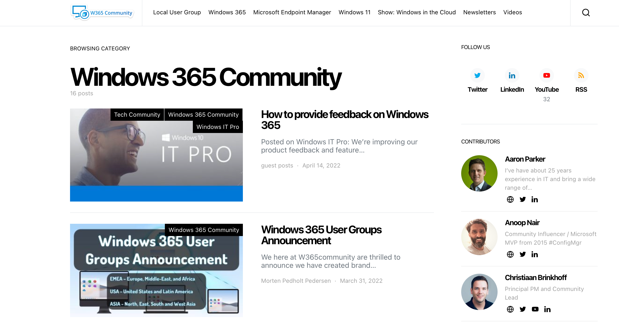
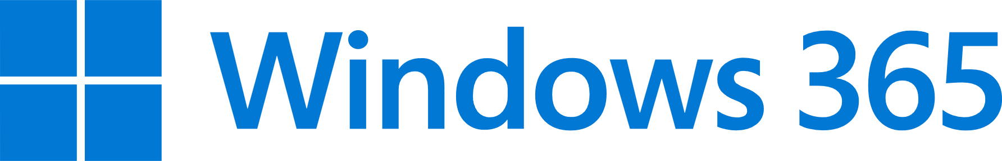
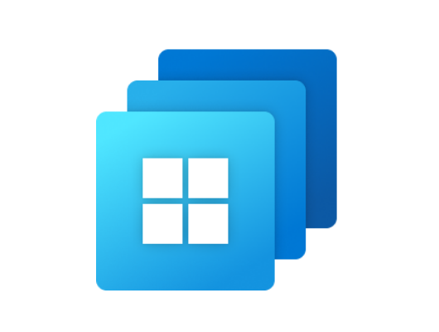
We bring Windows 365 news to you
Weekly newsletter
Knowledge shareing
Community newsletter
User Groups
USA
WINDOWS 365
USER
GROUP
ASIA
WINDOWS 365
USER
GROUP
EMEA
WINDOWS 365
USER
GROUP

Slide 5









The W365 Community Team
Sune Thomsen
@SuneThomsenDK
Modern workplace consultant
Microsoft MVP
Thomas Marcussen
@MarcussenThomas
Technology Architect & Evangelist
Microsoft MVP
Ola Ström
@olastromcom
Chief Technical Architect | MVP
Donna Ryan
@TheNotoriousDRR
Principal Engineer
Anoop Nair
@anoopmannur
Community Influencer Microsoft MVP
Jitesh Kumar
@jitesh8092
Technical Lead – IT
Microsoft MVP
Morten Pedholt
@MortenPedholt
Cloud Architect
Microsoft MVP
Juan Sifuentes
Sr Cloud Technical Specialist
Christiaan Brinkhoff
@Brinkhoff_C
Principal PM Community Lead

Slide 6



Stay in touch with us
@w365community
W365 community
Windows365 community
https://w365community.com

Slide 7
Physical PC vs Cloud PC

Slide 8


Physical PC

Slide 9

Cloud PC
Client Network
VPN
MS Network
RD Agents

Slide 10
Physical PC vs Cloud PC
Physical PC
Can be used without network connection
Support can help users remote or physical
No service/app dependencies in order to access the PC
Cloud PC
Require network connection
Support can only help users remote
RD Agent and network infrastructure must function correctly in order to work

Slide 11
Performance data

Slide 12
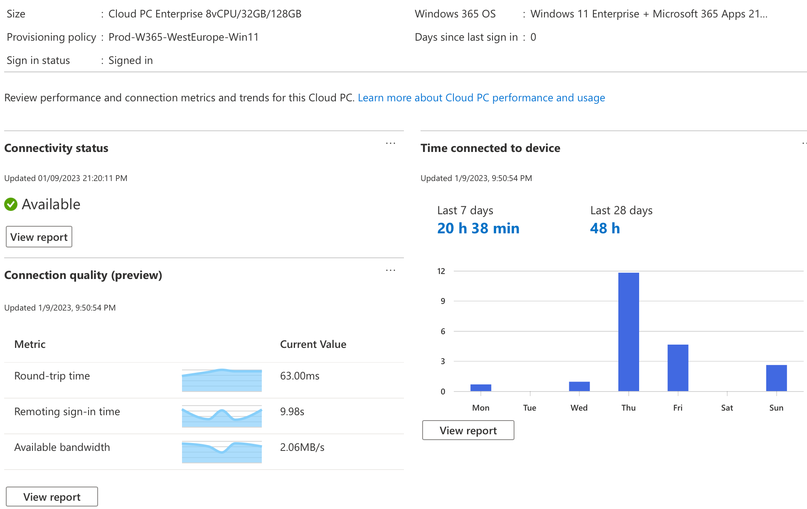
Data overview
Connectivity status
Connection quality
Cloud PC performance
Service health

Slide 13
Demo

Slide 14
Gather useful logs

Slide 15
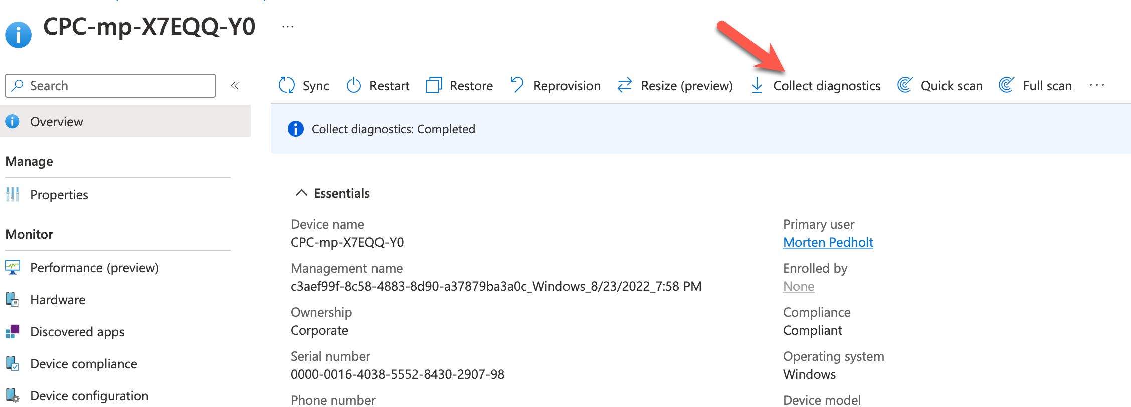
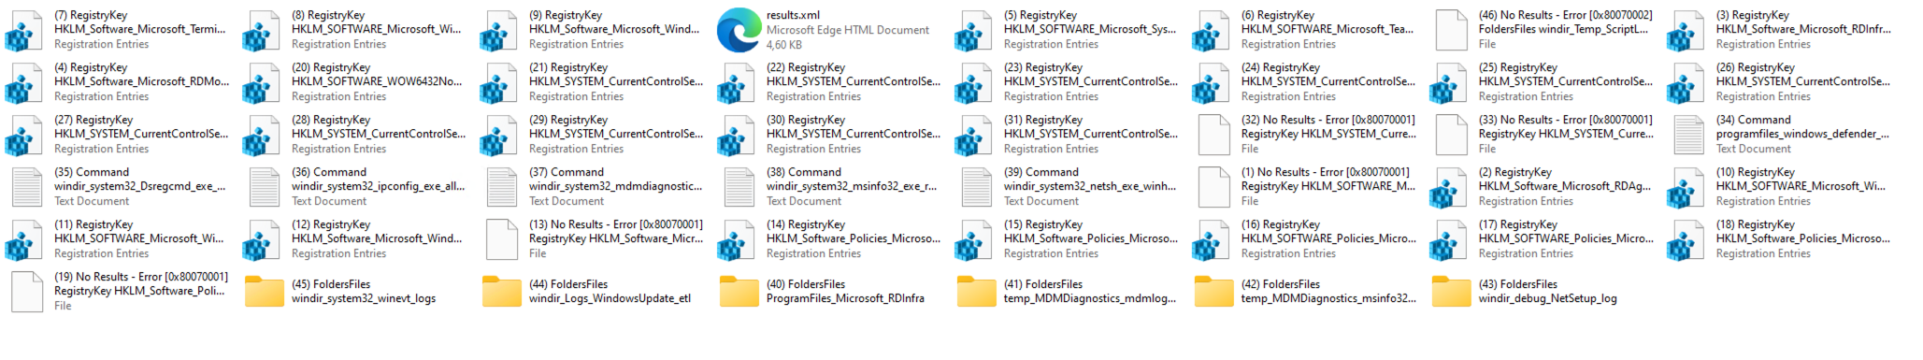
Collect Diagnostics

Slide 16
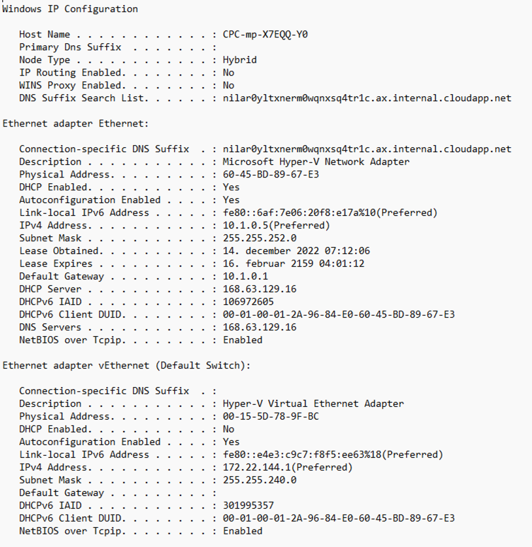
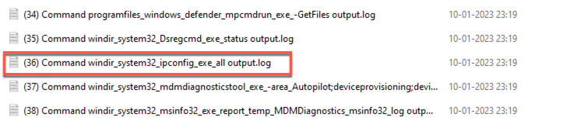
IPconfig

Slide 17
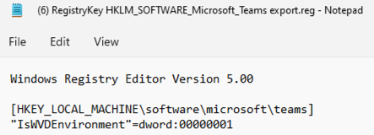
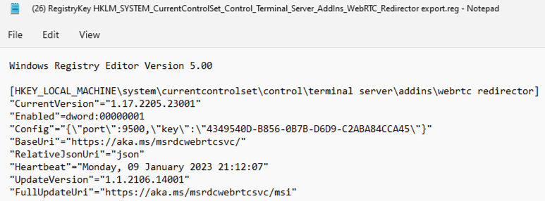
Teams AV Redirection Optimization

Slide 18
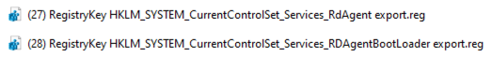

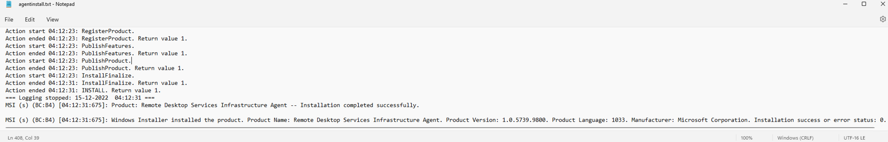
RD Agents and RDS config
Check RD Agent Services ( 27 and 28)
Check Terminal server configuration (25)
RD Agent updates and versions (40)

Slide 19

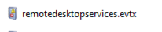
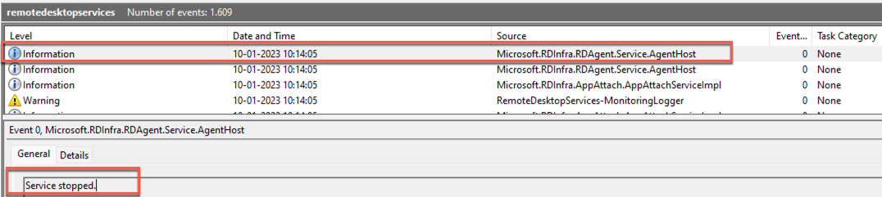
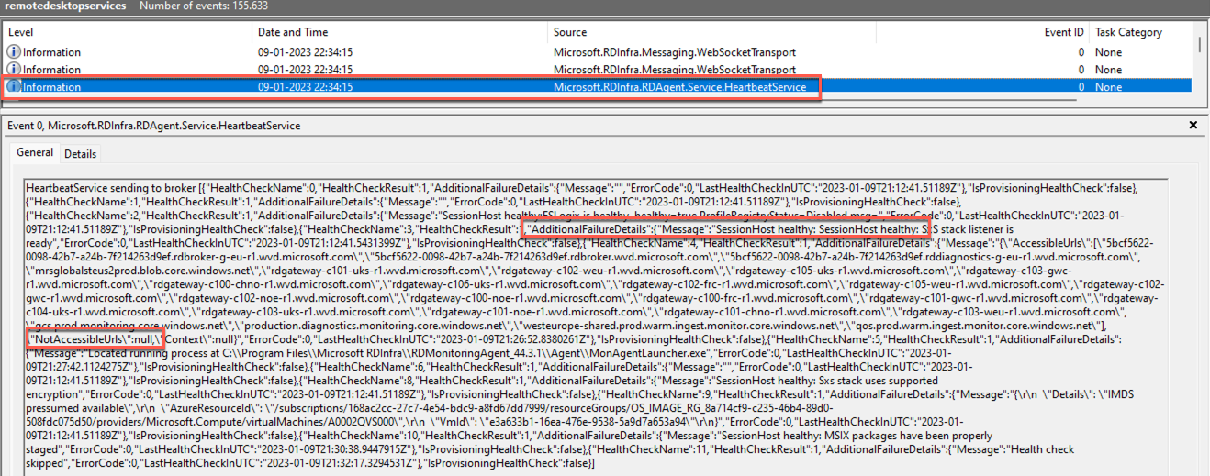
Event logs

Slide 20
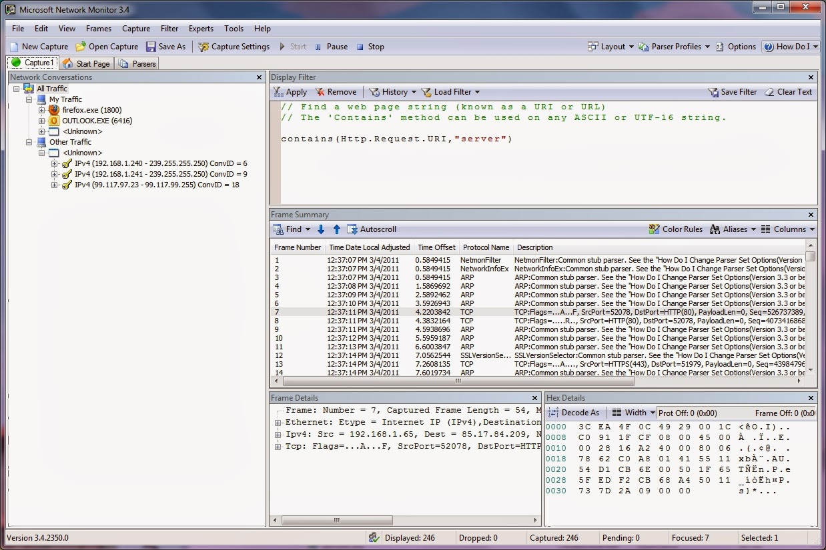
Microsoft Network Monitor
Capture network packets
Network performance issues
Alternatives:
Wireshark
NetworkMiner
Fiddler

Slide 21
Cloud PC Specific troubleshoot

Slide 22
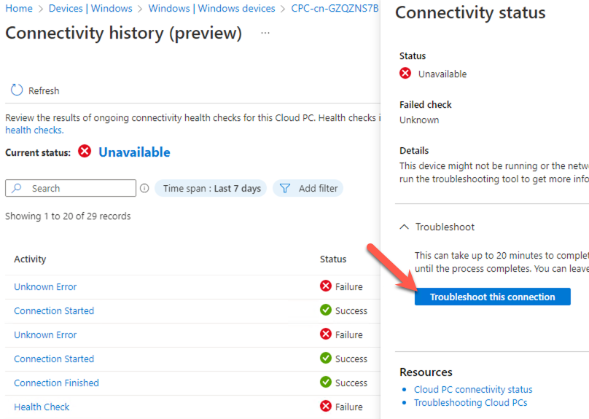
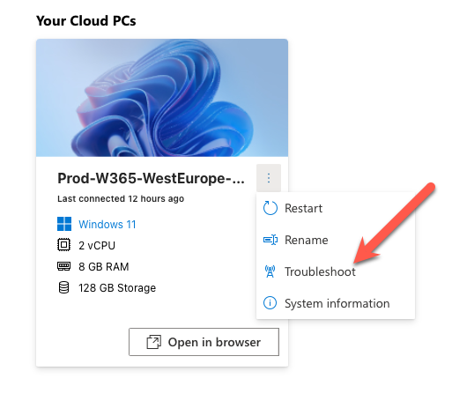
Cloud PC troubleshoot action
User action
Administrator action

Slide 23
If all access fails

Slide 24
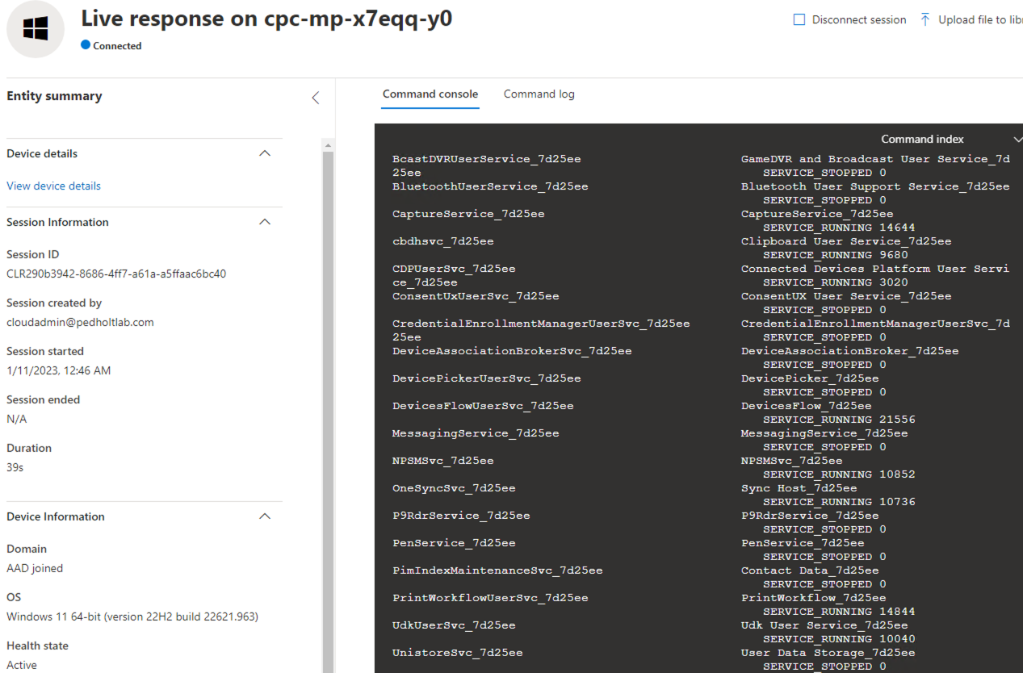
Live response session
Cloud-based Interactive Shell
Features
Run commands (limited)
Download files
Upload a file and run it
Required permissions
Security Administrator
https://security.microsoft.com

Slide 25
Demo

Slide 26
Free to use tips

Slide 27
Before you start deploying
Make sure to have a remote support tool
Exclude RDP traffic from VPN
Deploy your preferred tools as default
Patch Remote Desktop Client / Windows 365 APP
Microsoft support

Slide 28


Slide 29
Thank you!

